Slide 1


IOT
Home Automation With ESP32/ESP8266
GRADUATION DESIGN PROJECT-II
Dr. Öğr. Üyesi ABDULKADER ALWER
JUNE/2022
DONE BY
Abdalrhman AL-Afandi Hamzah Saleh Omar Shirwa
B1705.020042 B1805.020058 B1805.020056

Slide 2
Content
1-IOT general idea
2-Benefits of IOT
3-Esp pinouts
4-comparison with Arduino
5-Software And Applications
6-Programming
7-Diagrams and Video

Slide 3
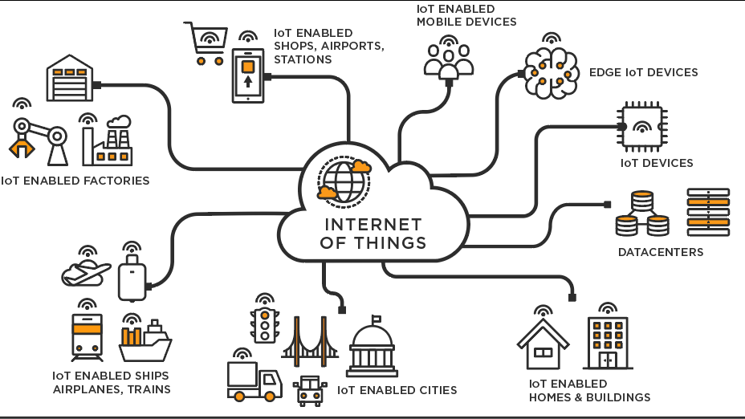

Slide 4
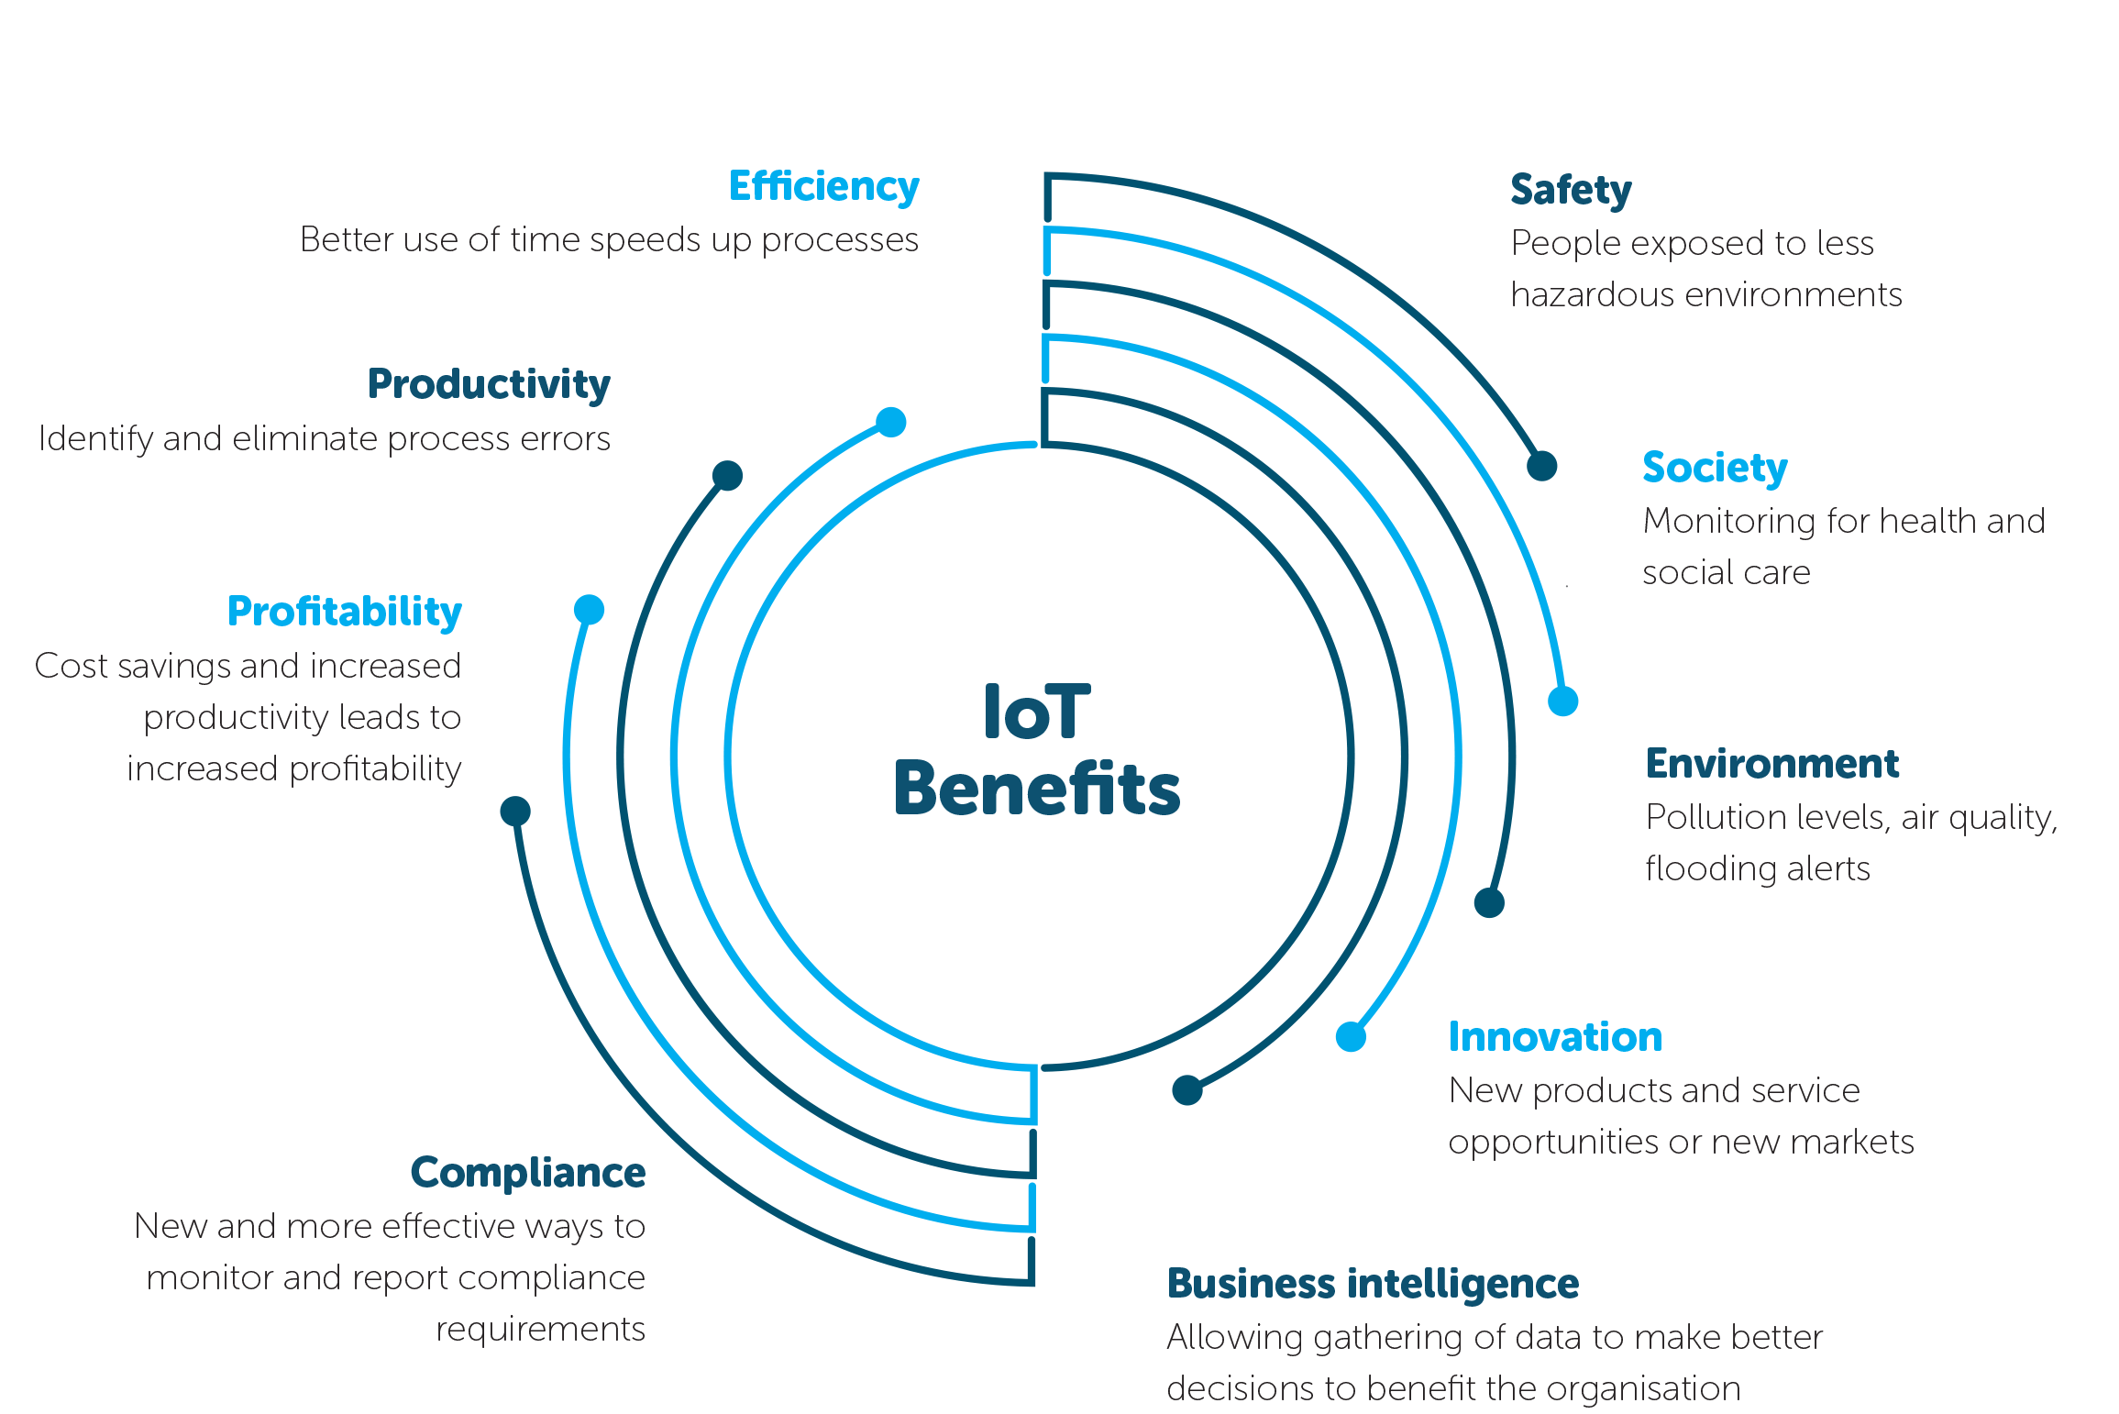

Slide 5
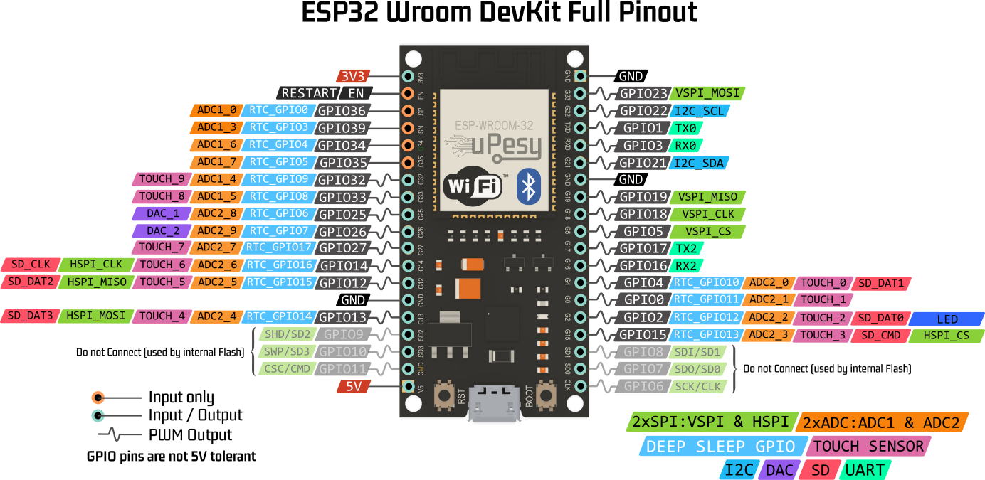

Slide 6
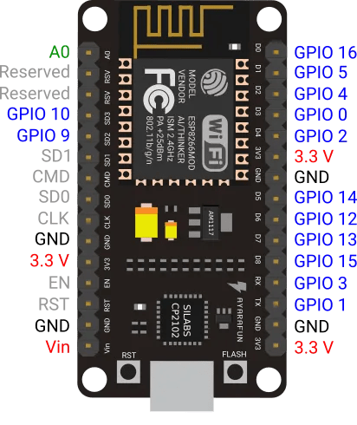
ESP8266 Full pinout

Slide 7
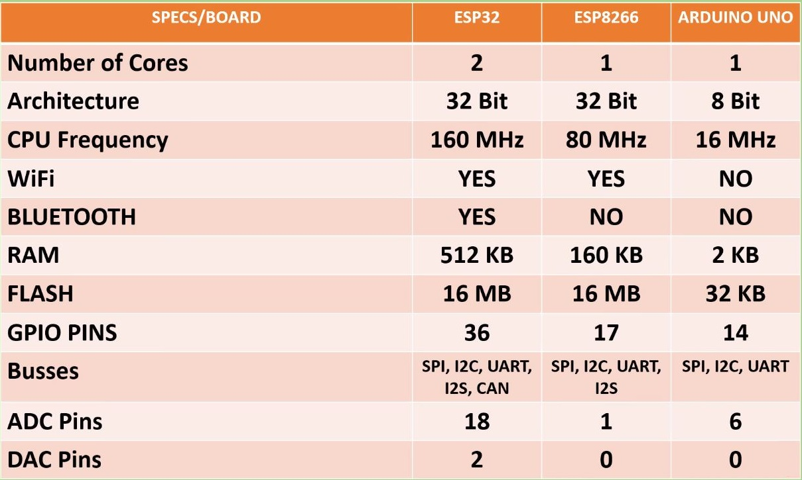

Slide 8



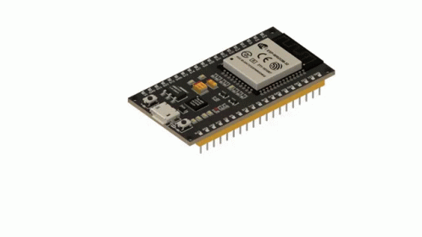


Software and application for Esp32
+

Slide 9
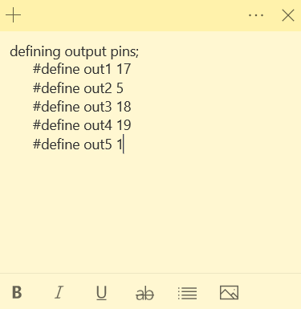
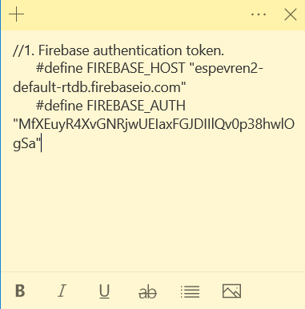
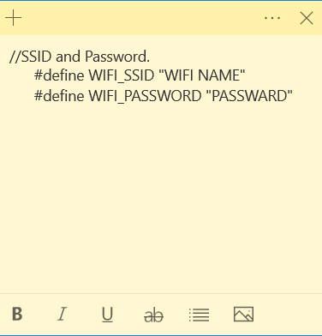
Programming of Esp32

Slide 10
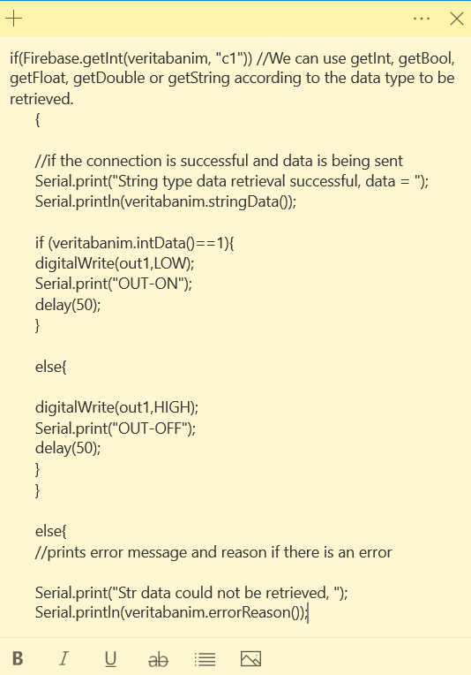
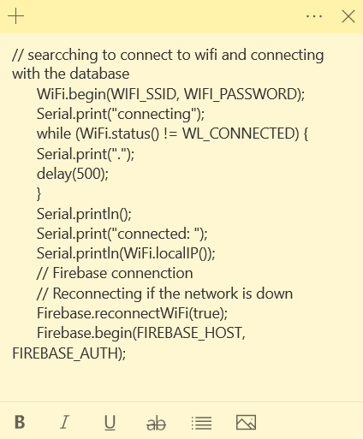
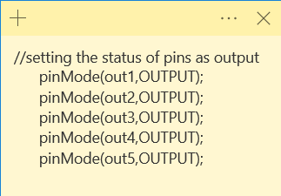

Slide 11


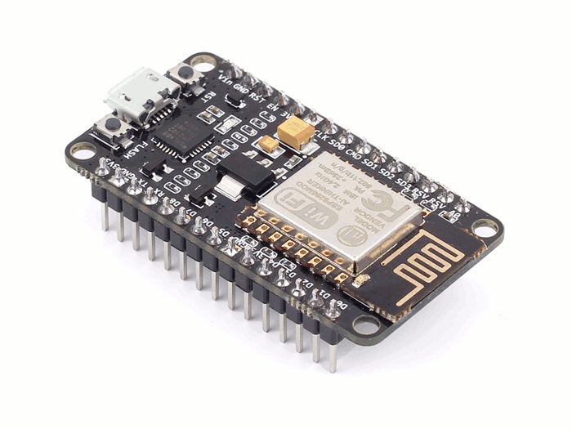
Software and application for Esp8266

Slide 12
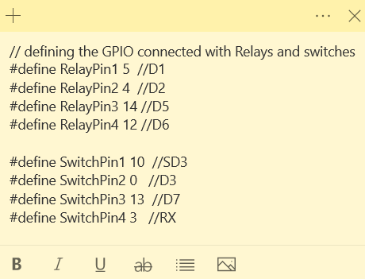
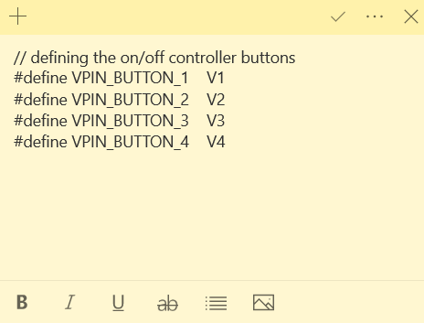
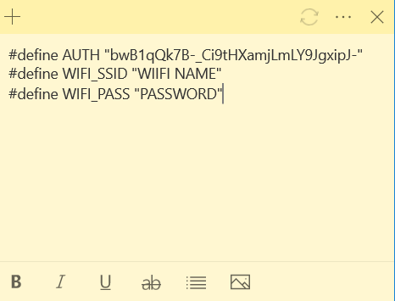
Programming of Esp8266

Slide 13
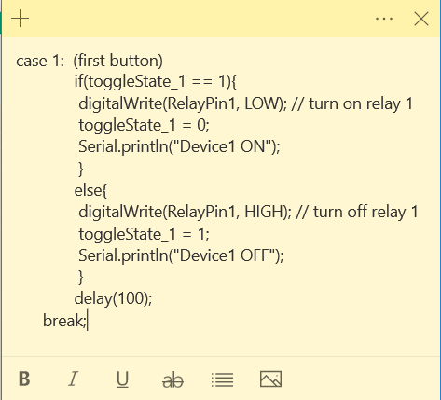
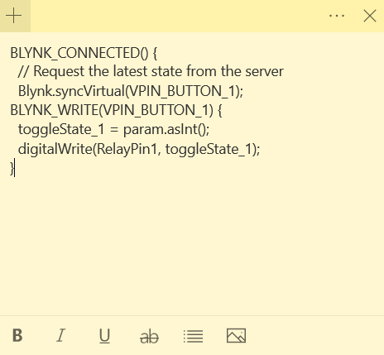
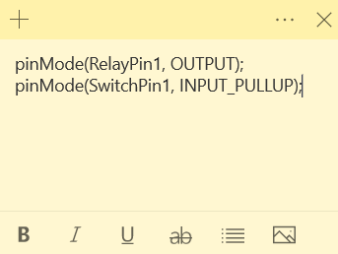

Slide 14
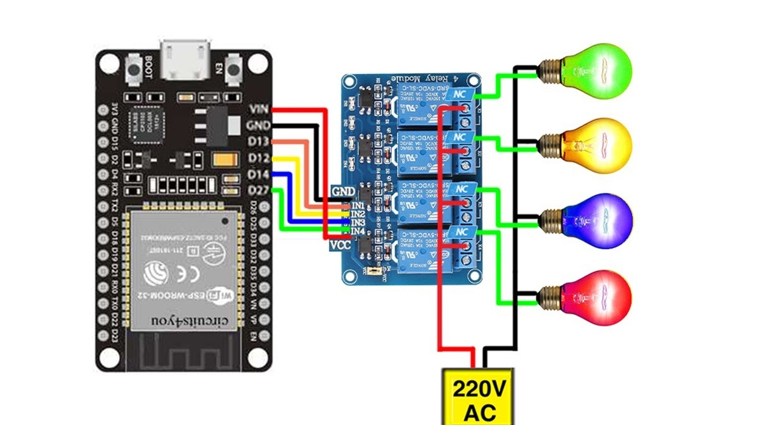

Slide 15
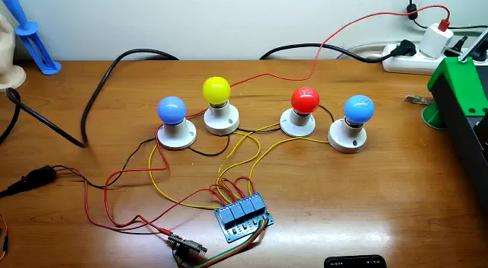

Slide 16
References
Internet of Things Principles and Paradigms by rajkumar buyya (buyya, 2016)
the definitive guide to firebase: build android apps on google's mobile platform (Moroney, 2017)
Smart Home Systems Based on Internet of Things (Domb, 2019)
industrial automation hands on (lamb, 2013)
internet-of-things (iot) systems architectures algorithms methodologies (Serpanos, Dimitrios, Wolf, Marilyn Claire,2017)
Designing the Internet of Things (Adrian McEwen, 2013) Kolban's Book on ESP8266 (Kolban, 2016)

Slide 17
